Slide 1
COMMITTEE ON JUSTICE AND
HUMAN RIGHTS
August 23, 2016
Notes:
(Greetings...)

Slide 2
SCOPE OF PRESENTATION
Situation
Crime Volume
Illegal Drugs
Previous Initiatives
MPO on 7 Focus Crimes
Kontra Droga Charlie
Current Initiative
Anti-Illegal Drugs Campaign Plan “Double Barrel”
Project Tokhang
Project HVT
Death Under Investigation (DUI), Outside Police Operation
Other Activities
Challenges
Assessment

Slide 3
Crime Volume
483,936
416,000
397,882
342,227
-14% TCV
-25% Index
-4% TCV
-22% Index
-14% TCV
-30% Index
Source: CRAC DIDM (Data Update: 8AM, 04 August 2016)

Slide 4
Illegal Drugs Affectation
Total Barangays – 42,036
Total Number of Barangays – 42,036
Source: PDEA
Notes:
Based on PDEA records, 11,321 barangays or 26.93% of the 42,036 nationwide are considered as “drug-affected”. Moreover, 941 minors were taken into custody before their turn-over to the DSWD. They were used and/or employed as runners, couriers and/or pushers of illegal drugs.
The problem on illegal drugs is largely felt in the barangays thus, there is a pressing need for a focused barangay-based clearing operations. The correlation between drugs and crime is prevalent in areas where drug affectation is high. The move is to harness the potentials of the Local Government Units (LGUs), government agencies, the PDEA and other law enforcement units to collectively launch barangay drug clearing operations, with each agency having a specific task to perform following the Whole of Government approach.

Slide 5
Illegal Drugs Affectation
Drug Affectation of Metro Manila
98 Barangays
1,611 Barangays
Source: NCRPO
Notes:
Based on PDEA records, 11,321 barangays or 26.93% of the 42,036 nationwide are considered as “drug-affected”. Moreover, 941 minors were taken into custody before their turn-over to the DSWD. They were used and/or employed as runners, couriers and/or pushers of illegal drugs.
The problem on illegal drugs is largely felt in the barangays thus, there is a pressing need for a focused barangay-based clearing operations. The correlation between drugs and crime is prevalent in areas where drug affectation is high. The move is to harness the potentials of the Local Government Units (LGUs), government agencies, the PDEA and other law enforcement units to collectively launch barangay drug clearing operations, with each agency having a specific task to perform following the Whole of Government approach.

Slide 6
Illegal Drugs Affectation
Drug Affectation of Region 3
656 Barangays
2,446 Barangays
Source: PRO 3
Notes:
Based on PDEA records, 11,321 barangays or 26.93% of the 42,036 nationwide are considered as “drug-affected”. Moreover, 941 minors were taken into custody before their turn-over to the DSWD. They were used and/or employed as runners, couriers and/or pushers of illegal drugs.
The problem on illegal drugs is largely felt in the barangays thus, there is a pressing need for a focused barangay-based clearing operations. The correlation between drugs and crime is prevalent in areas where drug affectation is high. The move is to harness the potentials of the Local Government Units (LGUs), government agencies, the PDEA and other law enforcement units to collectively launch barangay drug clearing operations, with each agency having a specific task to perform following the Whole of Government approach.

Slide 7
Illegal Drugs Affectation
Drug Affectation of Region 4A
1,007 Barangays
3,011 Barangays
Source: PRO 4A
Notes:
Based on PDEA records, 11,321 barangays or 26.93% of the 42,036 nationwide are considered as “drug-affected”. Moreover, 941 minors were taken into custody before their turn-over to the DSWD. They were used and/or employed as runners, couriers and/or pushers of illegal drugs.
The problem on illegal drugs is largely felt in the barangays thus, there is a pressing need for a focused barangay-based clearing operations. The correlation between drugs and crime is prevalent in areas where drug affectation is high. The move is to harness the potentials of the Local Government Units (LGUs), government agencies, the PDEA and other law enforcement units to collectively launch barangay drug clearing operations, with each agency having a specific task to perform following the Whole of Government approach.

Slide 8
Baseline Watch List on Illegal Drugs
(BADAC)
As of June 30, 2016
Total : 144,202
Source: DI
POLICE REGIONAL OFFICES
Notes:
Based on PDEA records, 11,321 barangays or 26.93% of the 42,036 nationwide are considered as “drug-affected”. Moreover, 941 minors were taken into custody before their turn-over to the DSWD. They were used and/or employed as runners, couriers and/or pushers of illegal drugs.
The problem on illegal drugs is largely felt in the barangays thus, there is a pressing need for a focused barangay-based clearing operations. The correlation between drugs and crime is prevalent in areas where drug affectation is high. The move is to harness the potentials of the Local Government Units (LGUs), government agencies, the PDEA and other law enforcement units to collectively launch barangay drug clearing operations, with each agency having a specific task to perform following the Whole of Government approach.

Slide 9
Previous Initiatives

Slide 10
Previous Initiatives
Managing Police Operations
7 Focus Crimes (Murder, Homicide, Robbery, Theft, Carnapping, Motornapping, Physical Injuries)
Illegal Drugs
Implementation of PNP Kontra Droga Charlie
Notes:
Given these targets, the following actions were taken...
The PNP...
Deploys more policemen to saturate high crime areas and high traffic convergence zones through the implementation of Managing Police and Patrol Operations;
Increases police presence by activating the Patrol Operations Sections/Units in NCR Police Stations, City Police Offices, Component City Police Stations, and Municipal Police Stations nationwide; and
Conducts intelligence-driven operations to arrest identified Most Wanted Persons (MWPs) and Criminal Gangs (CGs).

Slide 11
Current Initiative
Implementation of PNP Anti-Illegal Drugs Campaign Plan “Double Barrel”
Project Tokhang
Project HVT
* Internal Cleansing
* Synccom
* Best Practices
Notes:
Given these targets, the following actions were taken...
The PNP...
Deploys more policemen to saturate high crime areas and high traffic convergence zones through the implementation of Managing Police and Patrol Operations;
Increases police presence by activating the Patrol Operations Sections/Units in NCR Police Stations, City Police Offices, Component City Police Stations, and Municipal Police Stations nationwide; and
Conducts intelligence-driven operations to arrest identified Most Wanted Persons (MWPs) and Criminal Gangs (CGs).

Slide 12
Project: “Double Barrel”
Period Covered: July 1 to August 22, 2016
Personally Appeared/Surrendered Total : 673,978
Personally Appeared/Surrendered User : 629,139
Personally Appeared/Surrendered Pusher : 44,839
Total Arrested : 11,784
Arrested User : 4,947
Arrested Pusher : 6,837
Killed Drug Personalities : 756

Slide 13
DRUG PERSONALITIES
Period Covered: July 1 to August 22, 2016
(91.62%)
(8.68%)
(0.17%)
(0.96%)
(1.32%)
TOTAL : 686,608 Drug Personalities

Slide 14
Project: “Double Barrel”
Period Covered: July 1 to August 22, 2016
PRO 3
Personally Appeared/Surrendered Total : 58,528
Personally Appeared/Surrendered User : 55,926
Personally Appeared/Surrendered Pusher : 2,602
Total Arrested : 1,777
Arrested User : 532
Arrested Pusher : 1,245
Killed Drug Personalities : 173

Slide 15
Project: “Double Barrel”
Period Covered: July 1 to August 22, 2016
PRO 4A
Personally Appeared/Surrendered Total : 61,809
Personally Appeared/Surrendered User : 55,844
Personally Appeared/Surrendered Pusher : 5,965
Total Arrested : 952
Arrested User : 254
Arrested Pusher : 698
Killed Drug Personalities : 77

Slide 16
Project: “Double Barrel”
Period Covered: July 1 to August 22, 2016
NCRPO
Personally Appeared/Surrendered Total : 38,766
Personally Appeared/Surrendered User : 35,616
Personally Appeared/Surrendered Pusher : 3,150
Total Arrested : 2,927
Arrested User : 2,251
Arrested Pusher : 676
Killed Drug Personalities : 230

Slide 17
PROJECT HVT
Killed | : | Mico Tan, Jeffry Diaz aka Jaguar
Arrested Surrender | : : | (9 Chinese nationals) Franz Sabalones, Odicta, Mayor Espinosa
LCEs, Other Personalities Total Value of Seized Dangerous Drugs | : : | 34 Php943 M

Slide 18
Police and AFP Personnel Killed and Wounded in Anti Illegal Drug Operations
Period Covered: July 1 to August 18, 2016
PNP
Killed: 9
Wounded: 18
AFP
Killed: 3
Wounded: 8

Slide 19
Index Crime Volume

Slide 20
Comparative Statistics
July 2015 vs July 2016
Source: CRAC DIDM (Data Update: 8AM, 04 August 2016)

Slide 21
STATISTICS ON 7 FOCUS CRIMES AND RAPE
Period Covered: July 1 to August 18, 2016
Murder, Homicide and Physical Injuries

Slide 22
STATISTICS ON 7 FOCUS CRIMES AND RAPE
Period Covered: July 1 to August 18, 2016
Robbery, Theft, Carnapping MV and Carnapping MC

Slide 23
STATISTICS ON 7 FOCUS CRIMES AND RAPE
Period Covered: July 1 to August 18, 2016
Rape

Slide 24
Nationwide Status, Focused Crimes
49% Decrease

Slide 26
Internal Cleansing

Slide 27
Internal Cleansing
Random Drug Test
Jan. 1, 2016-June 30,2016 : 56 (55-pnp/1-NUP)
July 1, 2016 to present : 74 (71-PNP/3-NUP)
Total : 130
DI CI Watch List : 301
Administratively Charged : 6
Criminally Charged : 7
Killed : 11
DUI : 4
Arrested : 20
Surrendered under : 42
PRRD Pronouncement
Voluntary Surrendered : 4 PNP / 1 NUP
Directorate for Intelligence

Slide 28
Transfer of Personnel
Total of Personnel Endorsed for Transfer | Transferred | Others
300 | 284 | Total - 16 Dismissed – 8 AWOL – 4 Suspended – 1 NRF (PAIS) – 3

Slide 29
Transfer of Personnel
Personnel involved in drugs identified by the President
Total of Personnel Identified | With Issued Orders to PHAU | Personnel Without Orders
70 | 42 | Total – 28 9 – Retired 13 – NFR (PAIS) 1 – AWOL 2 – Dismissed 1 – Double Entry 1 – PHAU (OSEC)

Slide 30
Best Practices

Slide 31
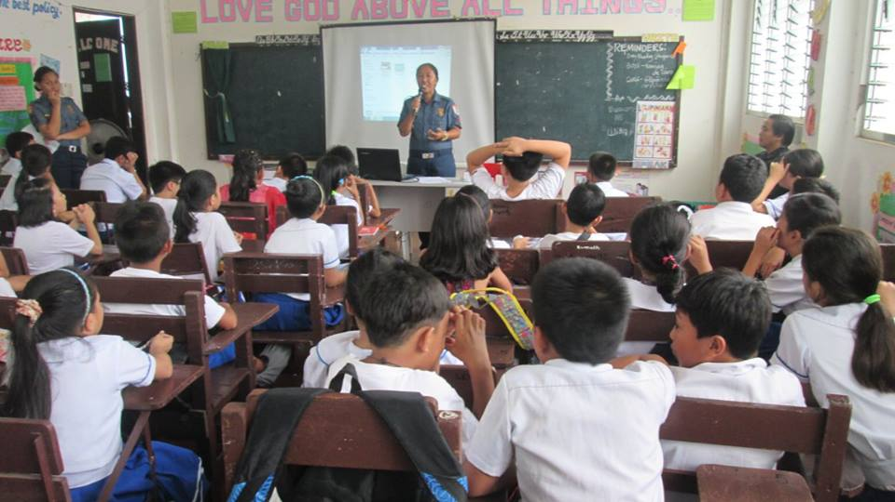
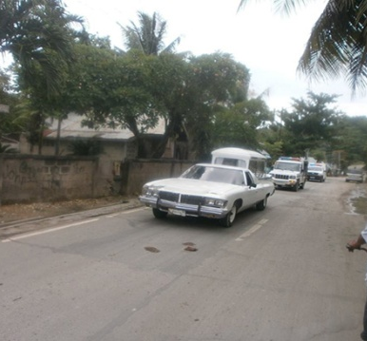
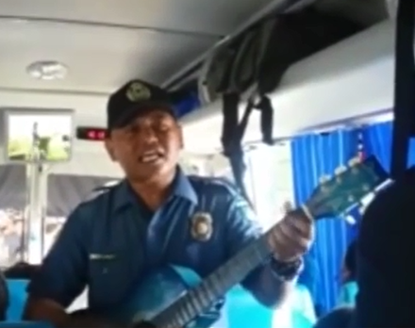
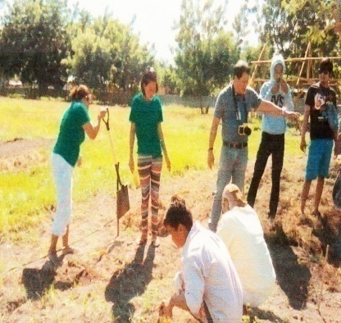
Best Practices
PRO 1 | - | Regional Inter Agency Committee on Illegal Drugs
PRO 3 | - | Shame Campaign Rallies
 | - | Balik Loob Program
 | - | Organization of Convenors
PRO 4A | - | Rehab Center in Sta. Rosa, Laguna
 | - | Kapit Bahay ko Bantay Ko
PRO 7 | - | Project Flash
 | - | Harana Laban sa Droga
 | - | Libreng Sakay : Free Funeral Ride Against Illegal Drugs
PRO 8 | - | Pasay Loa Ako
PRO 12 | - | “BALIK PAG-ASA” - Program for Surfacing Drug Personalities

Slide 32
PNP’s Synchronized Communication for “Project: Double Barrel”
DDB
PDEA
MPs
CPs
CPs
NBI
PPOs
CPs
PNP
PCP
CPs
DILG
PROs
CPs
CPs
CPs
DepEd
CPs
CPOs
CPs
CPs
DSWD
DOH
Other Govt Agencies
Notes:
The PNP has operationalized the Synchronized Communications (Synccom) in its anti-illegal drugs campaign plan or the “Project: Double Barrel”.
The Synccom aims to strengthen inter-agency coordination and cooperation for a “whole of government/multi-agency coordination approach”. The Synccom is a “one message, many voices” and a well-integrated courses of actions against illegal drugs.
The Synccom is a tested effective Best Practice in police operations during the Asia-Pacific Economic Cooperation Meetings in 2015 and the National and Local Elections 2016.

Slide 33
DEATH UNDER INVESTIGATION (DUI)

Slide 34
Death Under Investigation
Period Covered: July 1 to August 15, 2016
POLICE REGIONAL OFFICES
Total: 1,160

Slide 35
Death Under Investigation
Period Covered: July 1 to August 22, 2016
Age Bracket
Total number of victims – 1,160

Slide 36
Death Under Investigation
Period Covered: July 1 to August 22, 2016
Category
Total number of victims – 1,160

Slide 37
Death Under Investigation
Period Covered: July 1 to August 22, 2016
Nature of Incidents
Total number of victims – 1,070

Slide 38
Death Under Investigation
Period Covered: July 1 to August 15, 2016
Motive
Total number of victims – 1,070

Slide 39
Death Under Investigation
Period Covered: July 1 to August 15, 2016
Found Cadaver: 212

Slide 40
Death Under Investigated
Period Covered: July 1 to August 22, 2016
No. of Incidents Perpetrated by MRC
Total: 309

Slide 41
Deaths Investigated
Period Covered: July 1 to August 22, 2016

Slide 42
Deaths Investigated
Period Covered: July 1 to August 22, 2016
No. of Incidents : 268
No. of Victims : 285

Slide 43
Deaths Investigated
Period Covered: July 1 to August 22, 2016
Case Status
Total number of cases – 268

Slide 44
Deaths Investigated
Period Covered: July 1 to August 22, 2016
No. of Incidents Perpetrated by MRC
Total: 25

Slide 45
OTHER ACTIVITIES
Evaluation of Unit Commanders’ Performance
Validation of Reports
Social Impact Analysis (GIS)
SyncCom
Notes:
Thank you and good day.

Slide 46
CHALLENGES
Unsupportive LGEs
Unprepared LGUs
Budget allocation for drug testing
Notes:
Thank you and good day.

Slide 47
ASSESSMENT
The campaign against illegal drugs continues to gain momentum as manifested by the number of surrenderers.
The Anti-Illegal Drugs Campaign Plan “Double Barrel” contributed to the significant decrease in the total crime volume.
Death Under Investigation (DUI)/Found Cadavers are murder cases and are being investigated by the PNP.

Slide 48
ASSESSMENT
The implementation of the PNP Anti-Illegal Drugs Campaign Plan “Double Barrel” achieved the following:
revealed the true picture and magnitude of the drug problem in the country
persuaded drug personalities to appear voluntarily to the authorities
intensified police operations resulted in the reduction of crime incidents.
the Government’s War on Drugs is highly appreciated and supported by the public
Notes:
Thank you and good day.

Slide 49
End of Presentation
Notes:
Thank you and good day.

Slide 50
HYPERLINK
Notes:
Thank you and good day.

Slide 51
KILLED IN ACTION
RANK/NAME | DATE | AREA OF OPERATION
SPO3 LIMUEL MAHABA PANLIGAN | July 17, 2016 | Batangas
PO2 ARMAND VILLANUEVA JUPIA | July 26, 2016 Incurred GSW | Zamboanga Del Sur (Aug 18, 2016 date of death)
SPO3 EDMAR BUMAGAT | Aug 3, 2016 | Makati City
PO3 JERSON C AUTIDA | Aug 10, 2016 | Bukidnon
PSINSP ORLANDO R GUIRA | Aug 13, 2016 | Tacurong City
PO3 NESTOR DIMAANO DIMAANO | Aug 18, 2016 | Batangas
PSINS MARK GIL S GARCIA | Aug 20, 2016 | Rizal
SPO3 MARLON NICOLAS | Aug 22, 2016 | Pangasinan
PO3 JENNY AGBAYANI | Aug 22, 2016 | Pangasinan
BACK

Slide 52
WOUNDED IN ACTION
RANK/NAME | DATE | AREA OF OPERATION
PCI MELANIO PASCUAL VINORAY | July 7, 2016 | Santiago City, Isabela
PSUPT JEAN S FAJARDO | July 3, 2016 | San Fernando, Pampanga
SPO1 BONIFACIO C CORPUZ | July 18, 2016 | Hermosa, Bataan
PO1 REY ANTHONY C CRISTOBAL | July 13, 2016 | Dinalupihan, Bataan
SPO1 ROBERTO L AMDEO |  | Cavite
PSINSP J-RALE O PAALISBO | July 13, 2016 | Leyte
PO3 JEROME G MENDOZA | July 13, 2016 | Leyte
PO2 ANTONIO DADOR JR. | July 13, 2016 | Leyte
SPO1 RONALD C EUGENIO | Aug 6, 2016 | Misamis Oriental
PSINSP RICKY BOY A REMOROZA | Aug 3, 2016 | Davao del Sur
PO2 JAN REYWAN L ABADIA | July 30, 2016 | Davao del Sur
PO2 AR JAY A BRAVO | Aug 3, 2016 | Davao del Sur
SPO1 NADZMIR AJIBON | Aug 2, 2016 | Jolo, Sulu
PO2 ROMMEL SARIBAN | Aug 11, 2016 | Lamitan, Basilan
PO1 JAINAL ARPA | Aug 11, 2016 | Lamitan, Basilan
PO2 ALVIN D TADUYO | July 28, 2016 | Taguig City
SPO3 NOE B BANDOQUILLO | July 1, 2016 | Marikina City
PO1 WILFREDO A CAHAYAG | July 1, 2016 | Marikina City
BACK

Slide 53
KILLED IN ACTION
Name | Place of Operations | Date and Time
CPL JOSEL P MIRAVALLES | Brgy. Nabalawag, Midsayap, Cotabato | 4:50 AM of August 14, 2016
PFC JAYPEE C DURAN | Brgy. Nabalawag, Midsayap, Cotabato | 4:50 AM of August 14, 2016
PO3(petty officer) DAR M. ESPALLARDO | Brgy. Nabalawag, Midsayap, Cotabato | 4:50 AM of August 14, 2016
BACK

Slide 54
WOUNDED IN ACTION
Name | Place of Operations | Date
2LT RUEL Q. FORTUNA | Brgy. Nabalawag, Midsayap, Cotabato | August 14, 2016
SGT AIRINIO B GRAFEL JR | Brgy. Nabalawag, Midsayap, Cotabato | August 14, 2016
CPL RONEL B GOLEZ | Brgy. Nabalawag, Midsayap, Cotabato | August 14, 2016
CPL DIO CEASAR ESPANOLA | Brgy. Nabalawag, Midsayap, Cotabato | August 14, 2016
PVT NORMEL F GRANDE | Brgy. Nabalawag, Midsayap, Cotabato | August 14, 2016
PFC ROMNICK CLERIGO | Brgy. Nabalawag, Midsayap, Cotabato | August 14, 2016
PVT EDGAR GEGONE | Brgy. Nabalawag, Midsayap, Cotabato | August 14, 2016
PFC CRIC JOHN FIGUEROA | Brgy. Nabalawag, Midsayap, Cotabato | August 14, 2016
BACK

Slide 55
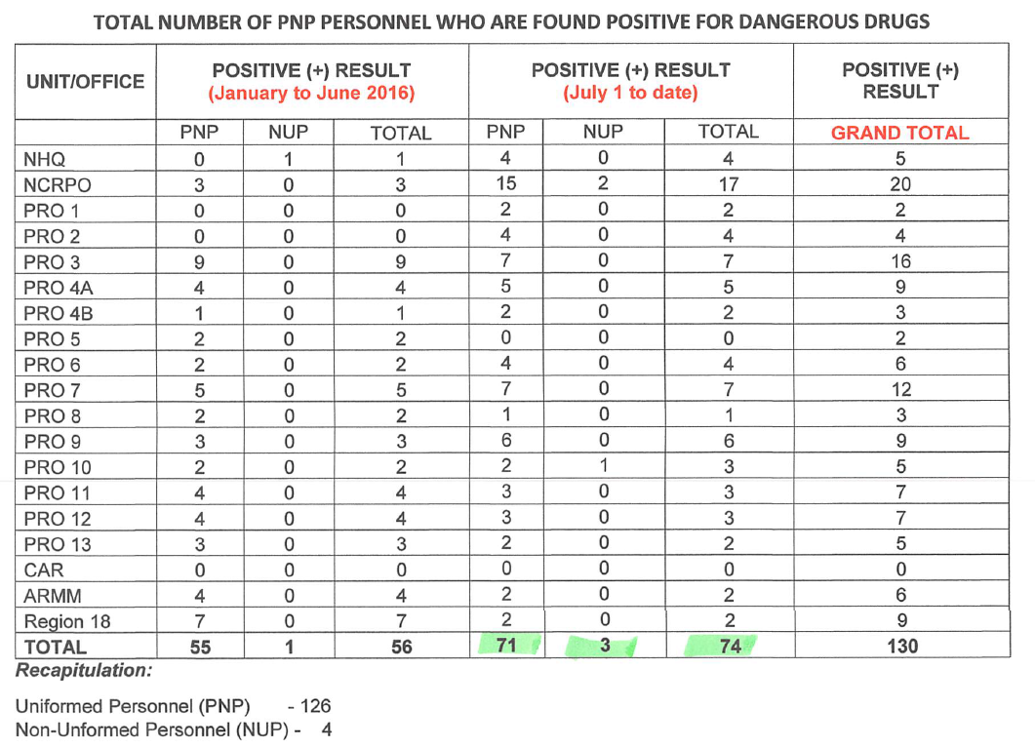
PNP Random Drug Testing Covering the period July 1, 2016 to August 22, 2016

Slide 56
PNP’s Synchronized Communication for “Project: Double Barrel”
DDB
PDEA
MPs
CPs
CPs
NBI
PPOs
CPs
PNP
PCP
CPs
DILG
PROs
CPs
CPs
CPs
DepEd
CPs
CPOs
CPs
CPs
DSWD
DOH
Other Govt Agencies
Notes:
The PNP has operationalized the Synchronized Communications (Synccom) in its anti-illegal drugs campaign plan or the “Project: Double Barrel”.
The Synccom aims to strengthen inter-agency coordination and cooperation for a “whole of government/multi-agency coordination approach”. The Synccom is a “one message, many voices” and a well-integrated courses of actions against illegal drugs.
The Synccom is a tested effective Best Practice in police operations during the Asia-Pacific Economic Cooperation Meetings in 2015 and the National and Local Elections 2016.

Slide 57
Inter-Agency Committee on Anti-Illegal Drugs
EXECOM
Execom
Secretariat
Committee on Education and Awareness
Committee on
Prosecution
Committee on Law Enforcement
Committee on Rehabilitation
Alternative Development
DepEd, DILG,DSWD, CHED, PDEA, PNP, AFP, DDB, LGUs
DOJ, PNP, PDEA, NBI,BI,PCG, BOC, DOTC, AMLAC, BSP
PNP
DOH, DSWD, DOJ, DILG, PDEA, PNP, BJMP,BuCor, LGUs
DILG, DOLE, DSWD, DENR, TESDA
NTF Commander
CPNP
Oversight Committee
Chairman TDCO, PNP
Members – TDI, TDO, TDIDM, TDPCR, LS, PDEA, AFP, NBI, BOC, and BI
Intelligence Fusion Center
NTF Secretariat
Deputy TF Commander
TDCO
Monitoring Center
Evaluation Team
Information Operations Center
Task Group HVT
Task Groups LVT
(Tokhang)
Task Group
Internal Cleansing
Task Group
Education, Awareness and Rehab
Focus Teams
FIT
Intel
Focus Teams
Focus Teams
Focus Teams
Collaborative Agencies
Regional, Provincial, City and Municipal Focus Teams
Collaborative Agencies
Composite Teams
Collaborative Agencies
Composite Teams
Collaborative Agencies
Focus Teams
Focus Teams
Focus Teams
AIDG
CIDG
IG
AFP, PDEA, NBI
BI, BuCor, BJMP, BOC
PCG, LGUs
RDs -TG Commander,
PDs, DDs, CDs, and COPs are Provincial, District, City & Municipal
-STG Commanders
AFP, PDEA, NBI
ADACs, LGUs
D, IG – TG Commander
Members: DPRM, DI, DO, DIDM, DC, IAS, CIDG, CLG, HS, LS
DOJ, DILG, PDEA, PNP, AFP, DDB, NBI, BI, PCG, BOC, DOTC, AMLAC, BSP, LGUs
D, PCRG – TG Commander
Members: DPCR, DC, PCRG, HS, CLG, PIO, LS
DepEd, DILG,DSWD, DOH, DOJ, CHED, PDEA, PNP, AFP, DDB, BJMP, BuCor, LGUs

Slide 59
House Visited vs Personally Appeared USER/PUSHER
(Total by Week)
Period Covered: July 1 to August 22, 2016

Slide 60
No. of Operations vs Arrested/Killed
(Total by Week)
Period Covered: July 1 to August 22, 2016

Slide 61
AIDG Accomplishment
(Period Covered: June 30 to August 15, 2016)
SIGNIFICANT ACCOMPLISHMENT ON HVTs
August 11, 2016 - Adelina Subdivision 2, San Pedro, Laguna (Search Warrant Operations)
Arrest of eight (8) suspects) and two (2) KIA
Seized 4 pistols, 3 rifle grenades, 1 hand grenade, & 78 grams shabu worth P390,000.00
August 6, 2016– Brgy. Malekkeg, Sta. Marcela, Apayao (Anti-Illegal Drugs Recovery Operations)
Seized 14 containers (317,914 liters) of CPECs worth P254,331.20
August 5, 2016 – 6-7 Jasmin St., Hensonville, Malabañas, Angeles City (Search Warrant Operations)
Arrest of one (1) Foreign national
Seized 30 kilos of shabu worth P150M
July 30, 2016 – Gabion St., Purok Masagana, Kalawag 1, Isulan, Sultan Kudarat (Search Warrant No. 66-16)
Arrest of fifteen (15) suspects , four (4) at-large
Seized 200 grams Shabu worth P1M
July 22, 2016 – No. 21 Pinagbayanan St., Brgy. Lingunan Valenzuela City (Search Warrant No. 5193-16)
Arrest of five (5) Chinese nationals
Seized 5,809.1 grams Ephedrine, a dangerous drug worth P9,294,450.00

Slide 62
AIDG Accomplishment
(Period Covered: June 30 to August 15, 2016)
SIGNIFICANT ACCOMPLISHMENT ON HVTs
July 22, 2016 – Sta Monica., cor T. Santiago St., Plastic City Industrial Park, Brgy. Lingunan, Valenzuela City (Warrant of Arest )
Mico Tan (KIA)
Seized 5,930.20 grams Shabu worth P29,651,000.00
July 20, 2016 – Cebu International Airport (Interdiction Operation)
Arrest of Li Ming Zhou
Seized 4,052.10 grams Shabu worth P20,260,500.00
July 11, 2016 – Subic Bay, Barangay Calapandayan, Subic Zambales (Interdiction Operation)
Arrest of four (4) Chinese nationals
Seized 500 grams Shabu worth P2.5M and lab equipment
July 3, 2016 – Barangay Culao, Claveria, Cagayan (Anti-Illegal Drugs Recovery Operations)
Seized 180 kgs Shabu worth P900M

Slide 63
Nationwide Status, Focused Crimes
Incidents | 2nd Sem 2015 (26 weeks) (Benchmark) |  |  | 1st Sem 2016 (26 weeks) |  |  | July 1-Aug 7, 2016 (CIRAS) (5 weeks) |  |  | Increase/Decrease from 2nd Sem 2015 compared to July 1-Aug 7, 2016 |  | Increase/Decrease from 1st Sem 2016 compared to July 1 - Aug 7, 2016
 | Total | Weekly Average | Daily Average | Total | Weekly Average | Daily Average | Total | Weekly Average | Daily Average | Weekly Average | Daily Average | Weekly Average | Daily Average
Murder | 4,827 | 186 | 27 | 4,420 | 170 | 24 | 1,321 | 264 | 35 | 42% | 31% | 55% | 43%
Homicide | 1,325 | 51 | 7 | 1,031 | 40 | 6 | 200 | 40 | 5 | -22% | -28% | 1% | -7%
Robbery | 15,486 | 596 | 85 | 11,772 | 453 | 65 | 1,476 | 295 | 39 | -50% | -54% | -35% | -40%
Theft | 38,967 | 1,499 | 214 | 27,518 | 1,058 | 151 | 3,562 | 712 | 94 | -52% | -56% | -33% | -38%
Carnapping | 6,596 | 254 | 36 | 5,473 | 211 | 30 | 599 | 120 | 16 | -53% | -57% | -43% | -48%
Phy Inj | 23,537 | 905 | 129 | 17,769 | 683 | 98 | 2,554 | 511 | 67 | -44% | -48% | -25% | -31%
TOTAL | 90,738 | 3,490 | 499 | 67,983 | 2,615 | 374 | 9,712 | 1,942 | 256 | -44% | -49% | -26% | -32%

Slide 64
Deaths Investigated
Period Covered: July 1 to August 22, 2016
Nature of Incidents
Total number of victims – 268

Slide 65
Deaths Investigated
Period Covered: July 1 to August 22, 2016
Motive
Total number of victims – 268

